Slide 1



PG-DAC Software project (Group 09)
Contributors:
210943020009 Ashraf Pathan
210943020034 Revan Kante
210943020101 Parag Taide
210943020110 Narendra Walvekar
Mentor:
Prof. Bakul Joshi

Slide 2
Back Seat only works if you have a Great Driver !!! Either Hire the Right one or take Charge & Drive !!!
“
”
- Harrish Sairaman

Slide 3
Agenda
1. Project Introduction
2. Project Architecture
3. Technology platforms used for project
4. User Roles and responsibilities
5. Division of work within team
6. known issues
7. Future extensions
8. Conclusion

Slide 4
Introduction
1. Purpose of the Project
Customers may have their vehicle, but self-driving takes the joy out of travel and binds them to the task of driving which may generate a lot of physical and mental stress, so they desire to be at ease during their journey. Many people own a vehicle but cannot drive, maybe because of sickness or physical disability or they just didn’t learn the driving; hence they prefer hiring a driver for their rides.

Slide 5
Goals
Assisting customers to find the best drivers for their rides 24/7.
Helping drivers who don’t have their vehicles and freelancers who enjoy driving on the weekends.
Allowing driver to confirm the ride as per his availability & convenience.
Allowing customers to pay only after the completion of the ride.
Keeping booking process flexible; allowing customers & drivers to cancel the booking before 2 days of the date of the ride without an extra charge.

Slide 6
Project Architecture
Used for
User Interfacing
Basic data validation
Used for
Server side validations
Response handling
Business logic
database operations
Front end layer
Used for
Permanent data storage
Database level validations
Server layer
Technologies used
React JS
Bootstrap
Database layer
Technologies used
Spring Boot REST API
Technologies used
MySQL

Slide 7
Technology platform used for the project (1/3)
1. Front end layer
Technologies used-
React JS
Potential to reuse components. It saves time for developers.
Only changed components are re-rendered because of virtual DOM.
Bootstrap
Saving time because of readymade templates.
Easy to Use
Responsive Grid System, Customizable, Cross-Browser Compatibility, Establish Consistency, Open-Source.

Slide 8
Technology platform used for the project (2/3)
2. Server Layer
Technologies used-
Java
Java is easy to learn, easy to use, easy to write, compile, debug,
object-oriented; create modular programs and reusable code
Spring boot REST API
Auto-configures your application automatically for certain dependencies
JPA
code their Java applications using object-oriented principles and best practices without having to worry about database semantics.

Slide 9
Technology platform used for the project (3/3)
3. Database Layer
Technologies used-
MySQL
open-source
Reliable
compatible with all major hosting providers
cost-effective
easy to manage
strong transactional support

Slide 10
User Roles and responsibilities
Customer
Driver
Admin
Book Ride
View Ride Details
View Ride history
Cancel Ride
Update profile
Browse Available Rides
Confirm Rides
View Ride Details
View Rides History
Cancel Ride
Browse Daily Scheduled Rides
Add new Cities in Database
Register New Driver

Slide 11
Division of work within team :
Ashraf
Revan
Requirements gathering
Database design
Stack of Customer Dashboard
Integrating the application
Requirements gathering
Database design
Stack of Login
Stack of Registration
Stack of Update Profile
Stack of Forgot password
Narendra
Parag
Requirements gathering
Database design
Stack of Ride booking
Stack of total fare generation
Stack of Ride confirmation
Stack of Ride Cancellation
Stack of Driver dashboard
Requirements gathering
Database design
UI of Home page, About Us, Fare policy, Contact Us
Stack of Ride cancellation
Stack of Ride confirmation

Slide 12
Known issues:
Need to freeze the past dates in booking process
Need to show only Customer’s upcoming rides in rides cancellation process.
Putting a Payment button for customer

Slide 13
Future extensions
Online driver onboarding
Adding cities for pickup location
Implementing GPS for customer locality
Total fare regeneration after ride completes
Adding extra modes of payments
Driver rating & reviews
Deregistration of user from system
Add encryption for data security

Slide 14
Conclusion:
Successfully created application with the functionality with that, customer can book rides for their outstation round trips, drivers can view all available rides and confirm rides flexibly.
The application was tested very well and the errors were properly debugged. Unit testing also concluded that the performance of the system is satisfactory. All the necessary output is generated. This system thus provides an easy way to automate all the functionalities of consumption.
Key Learnings:
Version Controlling using GitHub
Functional Components in React
Implementation of full-fledged application

Slide 15


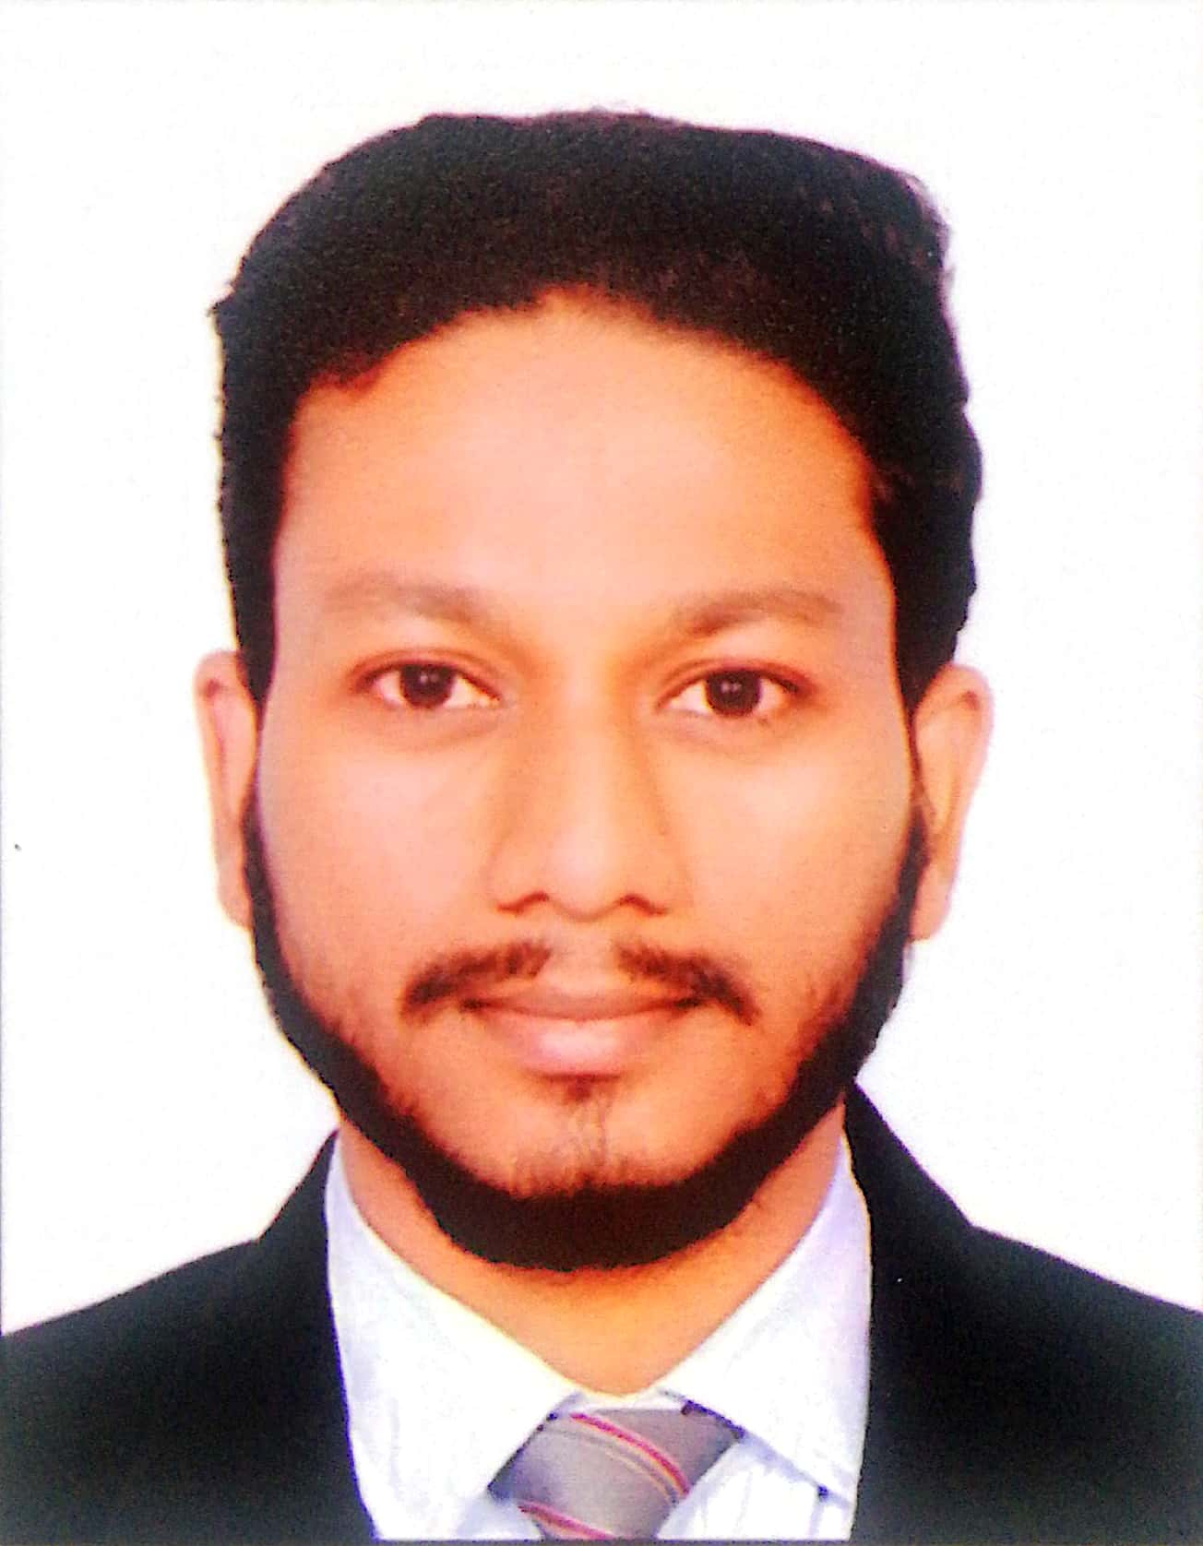
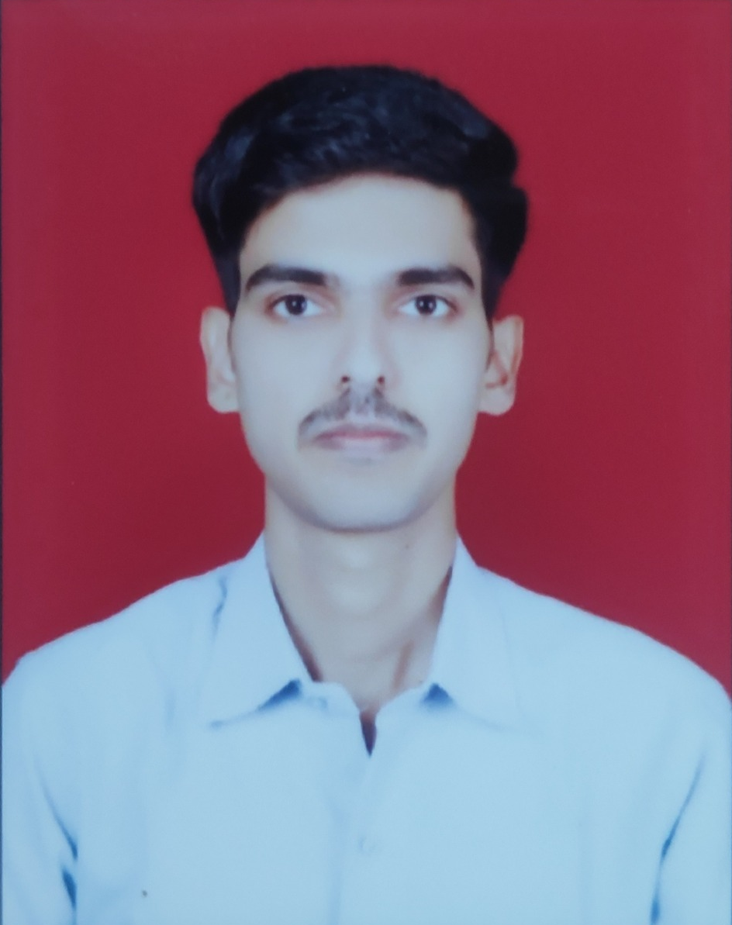
Meet our team
Parag
Revan
210943020101
210943020034
Ashraf
Narendra
210943020009
210943020110

Slide 16
Thank you !

